Slide 1
UE21CS320A – Capstone Project Approval
Project Title : Indexing and Summarization of Sports
Videos using Multi-Modal Approach
Project ID : 61
Project Guide : Dr. Sandesh B J
Project Team : PES2UG21CS289 (Meenal Bagare)
PES2UG21CS294 (Melvin Jojee Joseph)
PES2UG21CS324 (Naveen Kumar Reddy G)
PES2UG21CS242 (Krupashree M V)

Slide 2
Outline
Problem Statement
Scope, Workflow and Feasibility study
Challenges
Applications/Use cases
Novelty
Expected Deliverables
Capstone (Phase-I & Phase-II) Project Timeline
References

Slide 3
Problem Statement
In today's fast-paced world, sports enthusiasts lack time for full-length game viewing.
The process of creating sports summarization involves a manual, time-consuming process.
Large editing teams review entire game footage, select key moments, and compile highlights.
This manual approach is resource-intensive and may lead to uneven coverage of events.

Slide 4
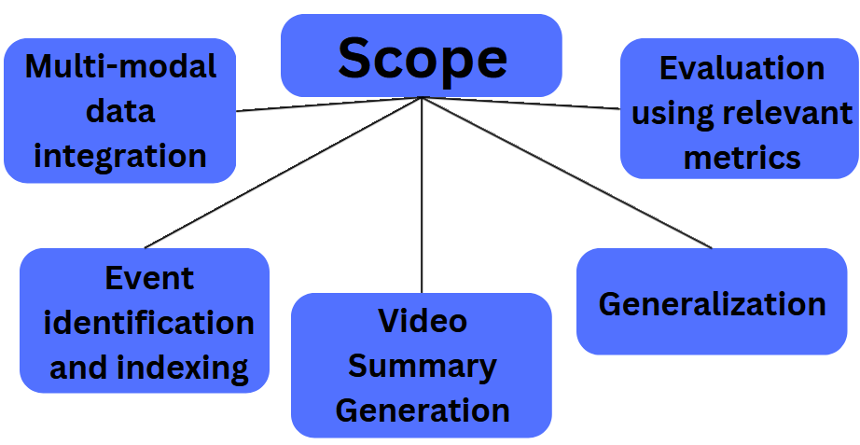
Scope

Slide 5

Scope
Multimodal Data Integration
Textual (Twitter) Data: Tweets provides insights and sentiments from a diverse audience during sports events. Twitter data adds a layer of authenticity, offering a unique perspective that complements audio and visual information.

Slide 6
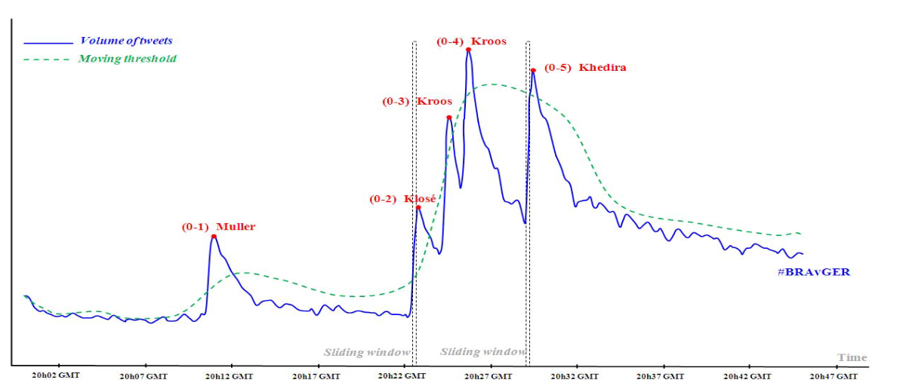
Scope
Graph taken from the research paper titled “Soccer Video Summarization using Social Media Streams”. Highlights detection on soccer game by applying moving-threshold burst detection. This example taken from the 2014 World Cup between Brazil and Germany; the red dot: represents the detected highlights; Blue line: represents the number of tweets

Slide 7

Scope
2. Audio data: Utilize newer deep learning models, to extract significant events from sports videos based on audio cues such as spectators’ cheering loudness factor or excitement of the commentator.
3. Visual data: Capture frames containing the scoreboard and employ image processing techniques to extract text within the scoreboard. Design algorithms to identify key events based on score changes.

Slide 8
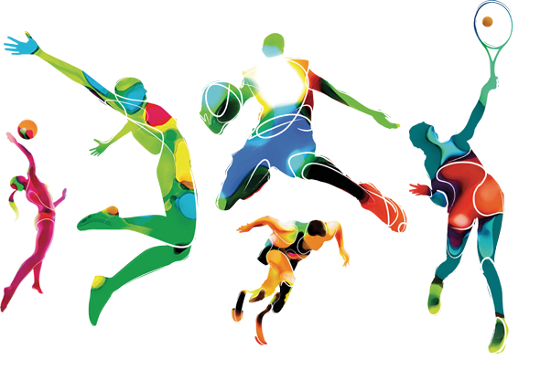
Scope
Event identification and indexing : Important events are identified based on the data obtained from all the modes. The important events have to be indexed based on their timestamp such that they can be efficiently retrieved while making the highlights video.
Video Summary generation: The creation of a summary video involves the merging of significant moments, previously identified and indexed, from the sports match. This process results in a condensed representation of the match highlights.

Slide 9

Scope
Generalization: The model's capability to generalize across a variety of sports is crucial. While acknowledging the complexity of this task, we aim to commence our efforts with a focus on one or two sports initially.
Evaluation: Evaluation of the video highlights using various metrics such as precision, recall, F1 score, intersection over union (IoU), mean average precision (mAP).

Slide 10
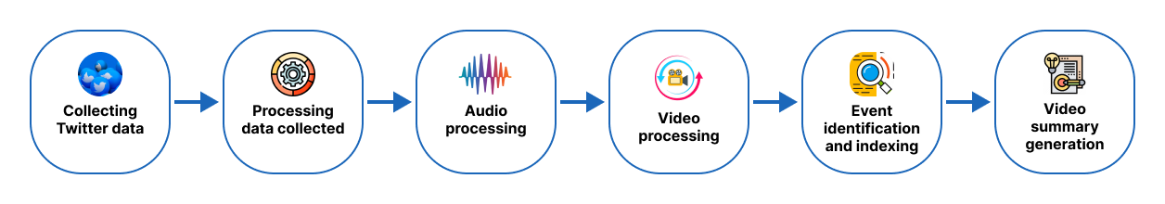
Workflow

Slide 11

Feasibility Study
1.Data Integration: Effective integration and processing of data from tweets, scoreboard updates ,crowd noise and commentators verbal cues for various sports events.
2. Real-time Processing: Providing highlights in real-time during sports events.
3.Development Time: A realistic timeline for project completion.

Slide 12

Challenges
1.Ensuring the reliability and quality of Twitter data can be challenging due to the presence of noise, spam, and fake accounts.
2.Different sports have unique characteristics and rules. Creating a generalized system that works well for diverse sports may be challenging.
3.Integrating information from both video and text sources requires effective multimodal analysis techniques which makes it challenging.

Slide 13
Challenges
4. The Scoreboard may not appear in consecutive frames. It was observed that the Scoreboard rapidly and randomly disappears. This disappearance and translation of Scoreboard challenge the performance of the Scoreboard extraction methods
5. Real-time Processing:Processing and summarizing video content, Twitter data, and scoreboard information in real-time requires efficient algorithms and infrastructure.Delays in processing may result in outdated or less relevant summaries.

Slide 14
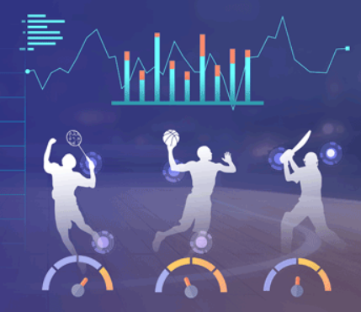
Applications/Use cases
1.Efficient Sports Video Highlight Enhance Fan Engagement.
2.Content Enrichment for Sports Streaming Platforms.
3.Sports Performance Analytics and Insights.
4.Educational Purpose in Sport Academies.
Notes:
Add more applications

Slide 15
Novelty
The distinctive novelty in our proposed problem statement lies in the seamless fusion of Twitter data in the first step along with audio and visual elements.
Combining social media reactions from Twitter along with audio and visual elements helps enrich the sports summarization experience through infusion of heightened emotional engagement.
Our objective is to integrate advancements from deep learning models.

Slide 16

Expected Deliverables
Capstone-I deliverables
● Problem statement
● Literature survey and data acquisition
● Design & architecture
Capstone-II deliverables
● Project Implementation
● Testing
● Optimization
● Project Report
● Draft Research Paper

Slide 17
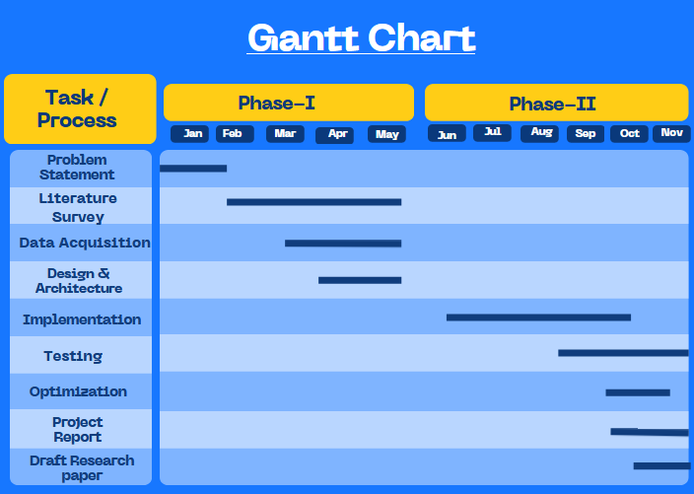
Capstone (Phase-I & Phase-II) Project Timeline
Notes:
Draft research paper

Slide 18
Dataset and References
Datasets
● Track my hashtag
● Sports videos
Research Papers
● A multimodal Approach for Automatic Cricket Video Summarization
Published in 2019 6th International Conference on Signal Processing and Integrated Networks (SPIN)
● Summarizing Sporting Events Using Twitter
Published in IUI '12: Proceedings of the 2012 ACM international conference on Intelligent User Interfaces
● Soccer Video Summarization using Video Content Analysis and Social Media Stream
Published in 2014 IEEE/ACM International Symposium on Big Data Computing
●Content-Aware Summarization of Broadcast Sports Videos: An Audio-Visual Feature Extraction Approach
Published online: 4 February 2020 ©Springer Science+Business Media, LLC, part of Springer Nature 2020
Notes:
http://www.jeffreynichols.com/papers/summary-iui2012.pdf
Summarizing Sporting Events Using Twitter
https://ieeexplore.ieee.org/document/7321723
Soccer Video Summarization using Video Content Analysis and Social Media Streams
https://link.springer.com/article/10.1007/s11063-020-10200-3

Slide 19
Thank You

